Slide 1

Welcome

Slide 2

Sales Dataset Analysis – Advanced Excel Project
Name : Deepti Horakeri​
Date : 30/12/2024​
Course : Data Science and Data Analytics​
Batch : B5 Online​

Slide 3
Objective:
To analyze sales data to identify trends, understand sales performance, and provide actionable business insights
Goals:
Analyze sales trends.
Identify high-performing products and sales channels.
Determine the impact of returns and discounts.
Create a dynamic dashboard with key metrics.

Slide 4
Dataset Overview
It contains following rows :
1.Row ID 2.Order ID 3.Order Date 4.Ship Date 5.Ship Mode 6.Customer ID 7.Customer Name 8.Segment 9.Country 10.City 11.State 12.Postal Code 13.Region 14.Product ID 15.Category 16.Sub-Category 17.Product Name 18.Sales 19.Quantity 20.Discount 21.Profit
Data Cleaning Process:
Removal of duplicates
Handling missing values
Data formatting

Slide 5
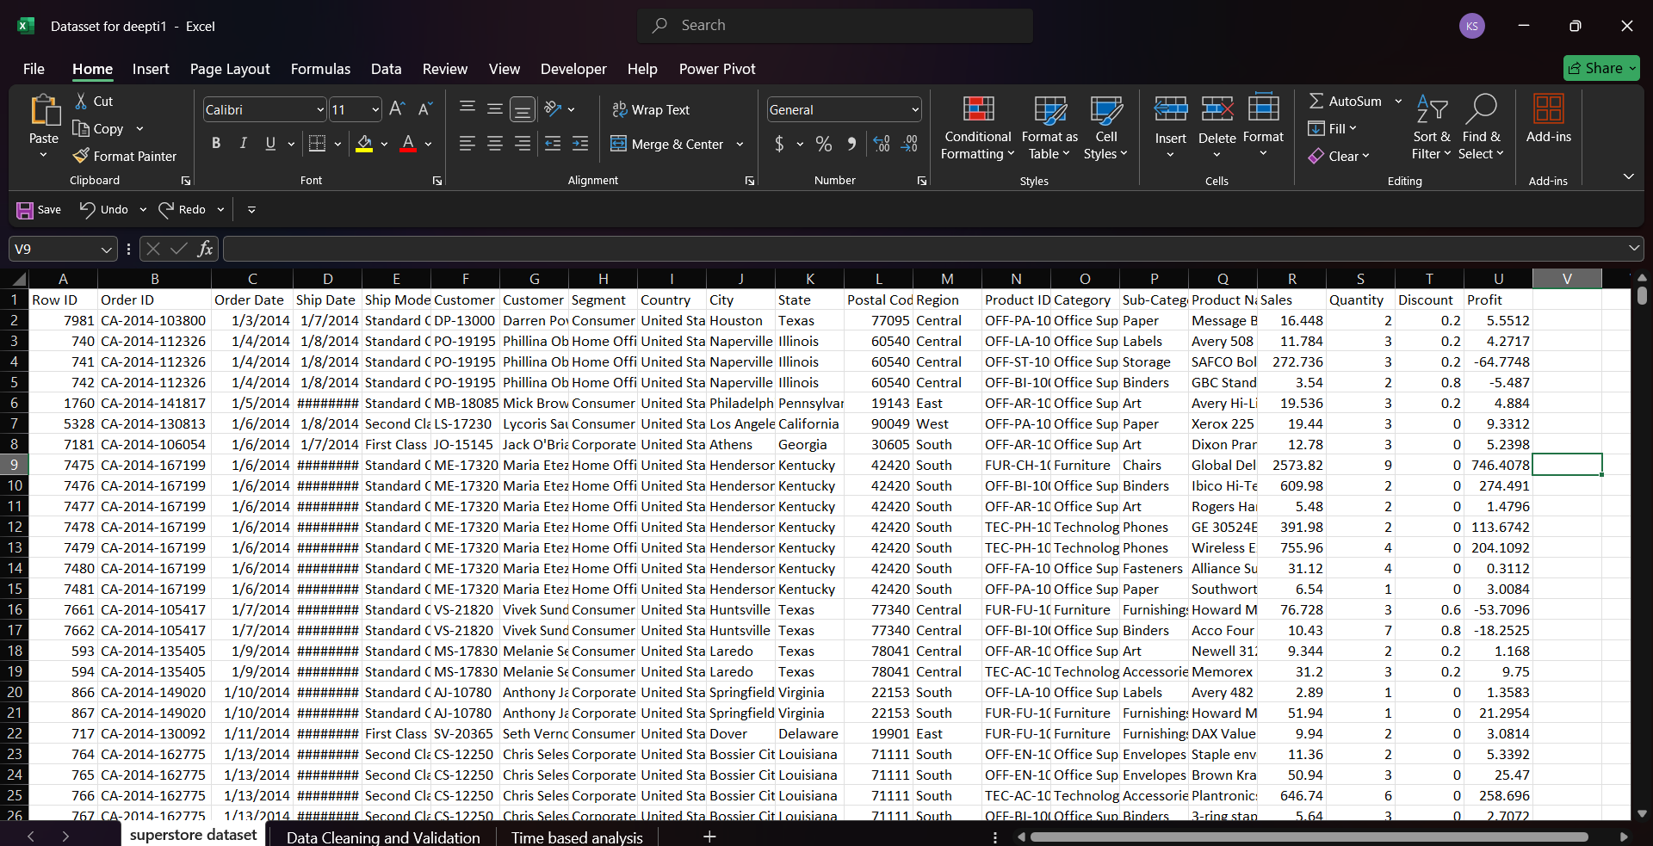
Before Cleaning Dataset:

Slide 6
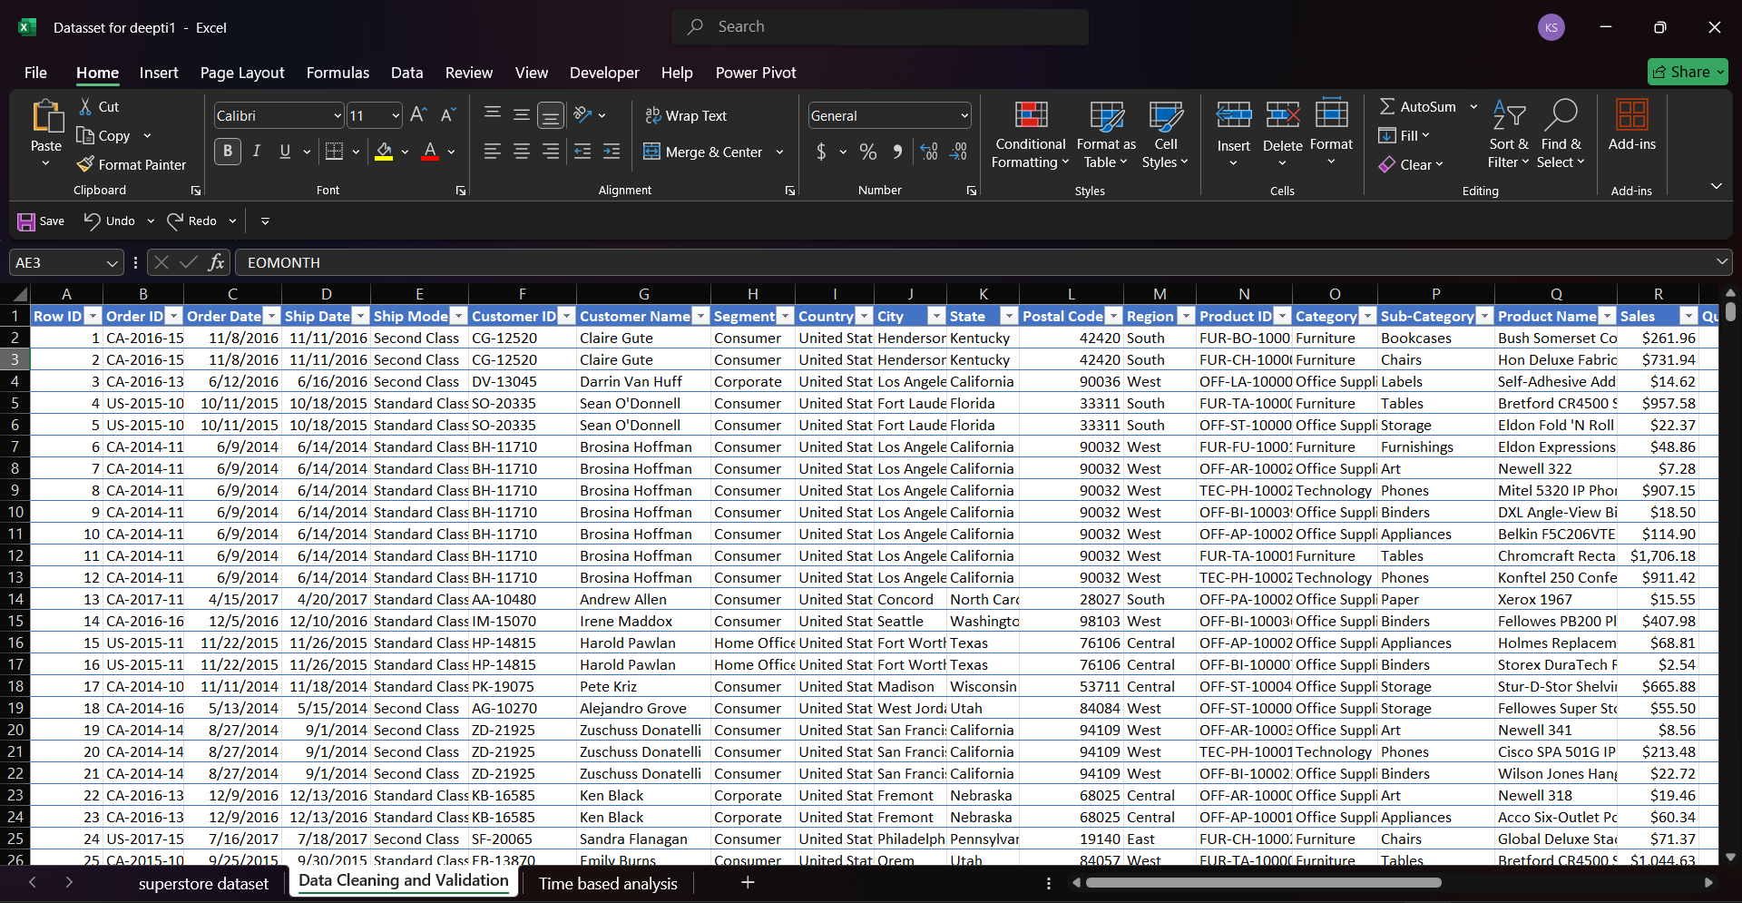
Dataset After Cleaning :

Slide 7
Important Calculations:
Total sales :
Gross Sales = Sales*Quantity
Net Sales = [Gross Sales]-[Discount]*100
Adjusted Sales = [Sales]*(1-[Discount]/100)
Average sales per order :
=AVERAGE(W2:W9995) where W column is for Adjusted Sales
Discount rates :
Discount Rate=Sales Price/Discount ×100
Sales by Segments :
=SUMIF([Segment],"Consumer",[Adjusted Sales])

Slide 8
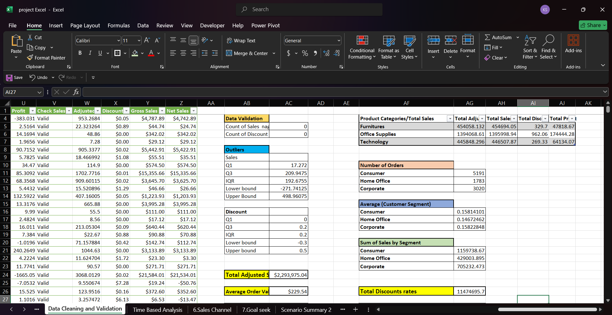
Screenshot :

Slide 9
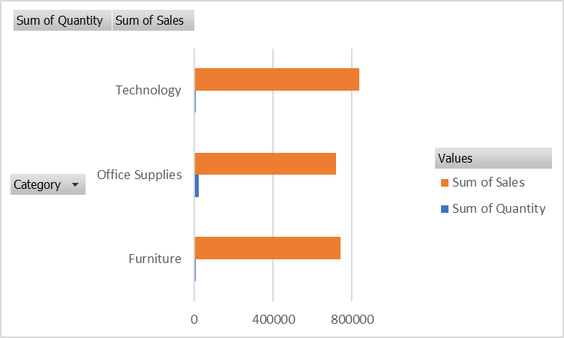
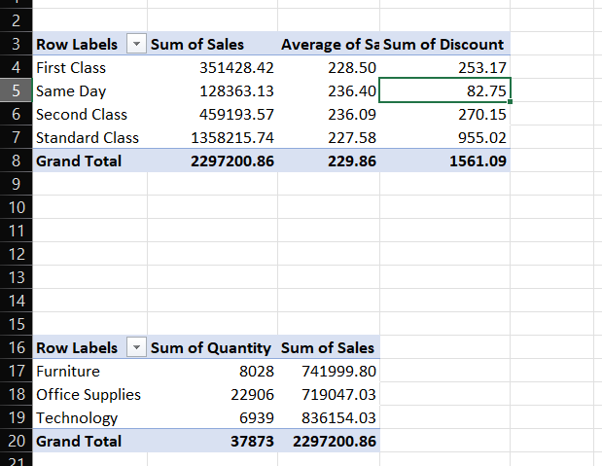
Pivot Tables and Pivot Charts :

Slide 10
Dashboard
Dashboard is a visual representation of a data in the form of charts and graphs which are easier to analyze.
They consolidate data from various sources into a single interface.
Dashboard can be interactive by applying the slicers.
By providing actionable insights at a glance, dashboards support faster and more informed decision-making.

Slide 11
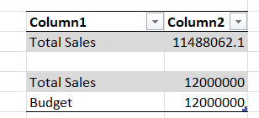
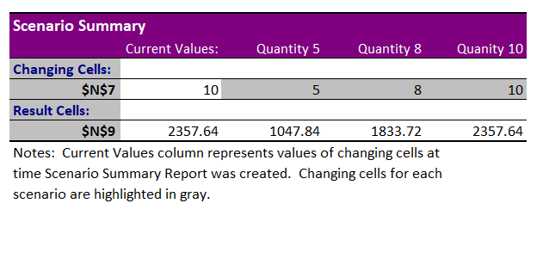
What-If Analysis & Goal Seek

Slide 12
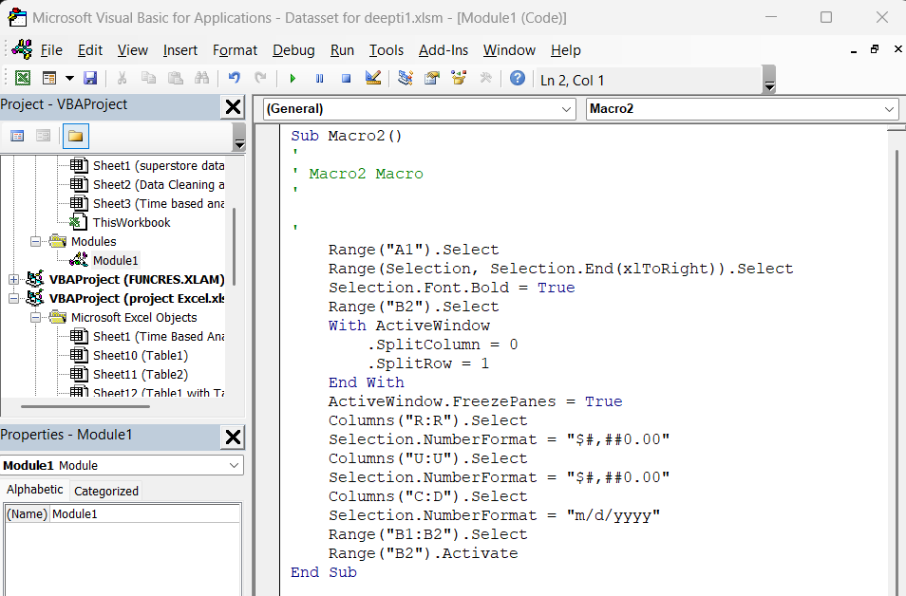
Macros and Automation

Slide 13
Insights and Recommendations
1.Overall Standard Class is having the highest Sales.
2.Based on Sales best in Technology (Phones) and low in Office Supplies(fasteners).
3.On comparing adjusted sales with Net sales is having large difference where after providing the discount sales increased.
4. By optimizing the discount strategies we can increase the sales and once which are having the losses has to be improved either by quality or other constraints has to be considered.

Slide 14

Thank You​

